Slide 1
X
Y

Slide 2
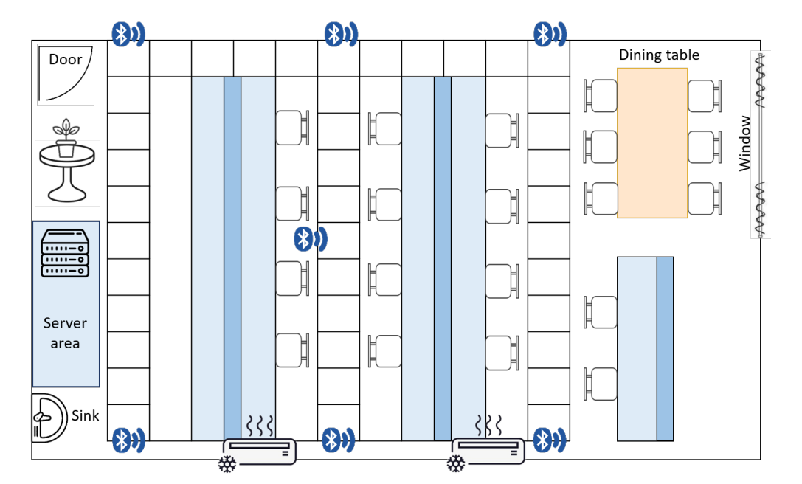
(5400,1100,1350)
(0,0)
X
(6000,1100)
(0,1100,1400)
(3810,2500,1600)
(530,2500,1500)
A
(6000,4100)
(0,4100,1400)
B
Y
C

Slide 4
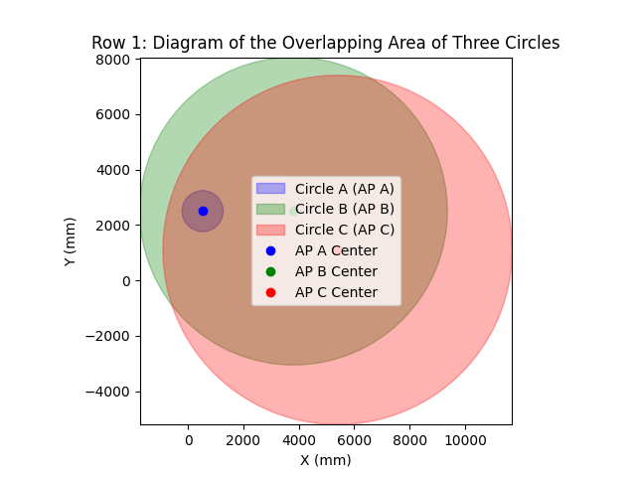

Slide 6
11 1.00 0.83 | 10 0.98 0.86 | 9 0.99 0.97 | 8 0.98 0.96 | 7 0.97 0.82 | 6 0.99 0.96 | 5 0.98 0.84 | 4 0.96 0.86 | 3 0.98 0.96 | 2 0.99 0.84 | 1 0.99 1.00
12 0.99 0.92 |  |  |  |  |  |  |  |  |  | 30 0.96 0.93
13 0.99 1.00 |  |  |  |  |  |  |  |  |  | 29 0.96 0.94
14 1.00 0.96 |  |  |  |  |  |  |  |  |  | 28 0.92 0.84
15 1.00 0.97 |  |  |  |  |  |  |  |  |  | 27 0.98 0.97
16 1.00 0.70 | 17 0.98 0.96 | 18 0.99 0.94 | 19 0.98 0.95 | 20 0.97 0.90 | 21 0.94 0.84 | 22 0.98 0.92 | 23 0.97 0.84 | 24 0.98 0.76 | 25 0.97 0.80 | 26 0.99 0.78
49 0.98 0.97 |  |  |  |  |  |  |  |  |  | 31 0.97 0.64
48 0.89 0.92 |  |  |  |  |  |  |  |  |  | 32 0.99 0.78
47 0.88 0.85 |  |  |  |  |  |  |  |  |  | 33 0.98 0.79
46 0.94 0.93 |  |  |  |  |  |  |  |  |  | 34 0.94 0.83
45 0.95 0.92 | 44 0.98 0.97 | 43 0.96 0.98 | 42 0.98 0.93 | 41 0.98 0.87 | 40 0.98 0.81 | 39 0.88 0.96 | 38 0.90 0.81 | 37 0.94 0.83 | 36 0.98 0.93 | 35 0.96 0.76

Slide 7
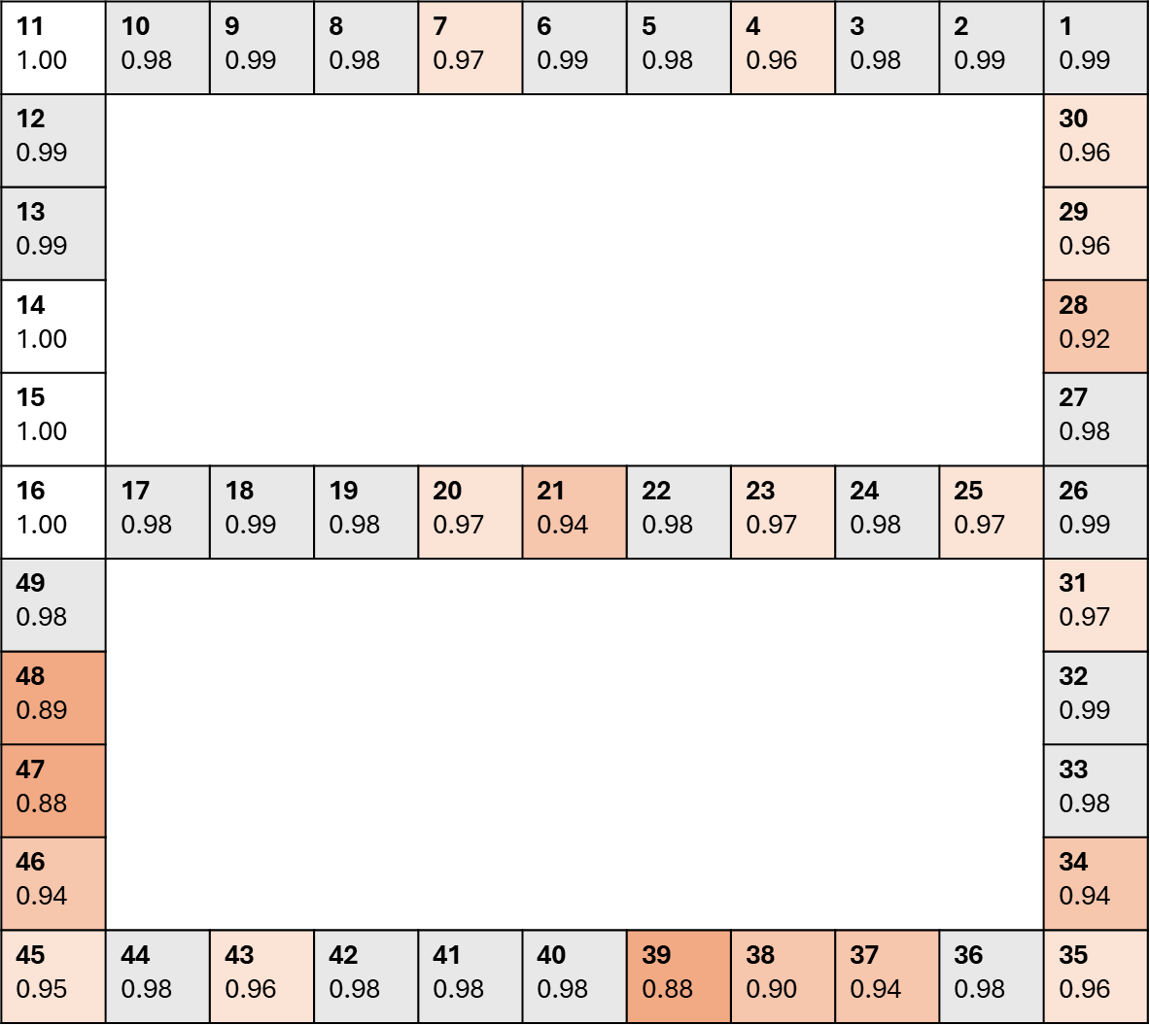

Slide 8
Server & fish
門
3
1
置物區
大鐵櫃
共用桌
2
4

